Slide 1
CUSTOMER RETENTION-
CASE STUDY

Slide 2
What is customer retention?
Customer retention means satisfying existing customers so they continue buying from your brand instead of competitors. It takes eight purchases for a customer to be considered a “regular” at a company, but customer retention is about much more than repeat orders.

Slide 3
Why is it important?
Optimizing the customer experience and listening to their needs leads to lifetime brand loyalty, plus major financial benefits. On average, attracting a new customer costs five times as much as keeping an existing one, plus up to 30 times the marketing cost. However, increasing customer retention rates by just 5% can boost your profits by 25% to 95%!

Slide 4
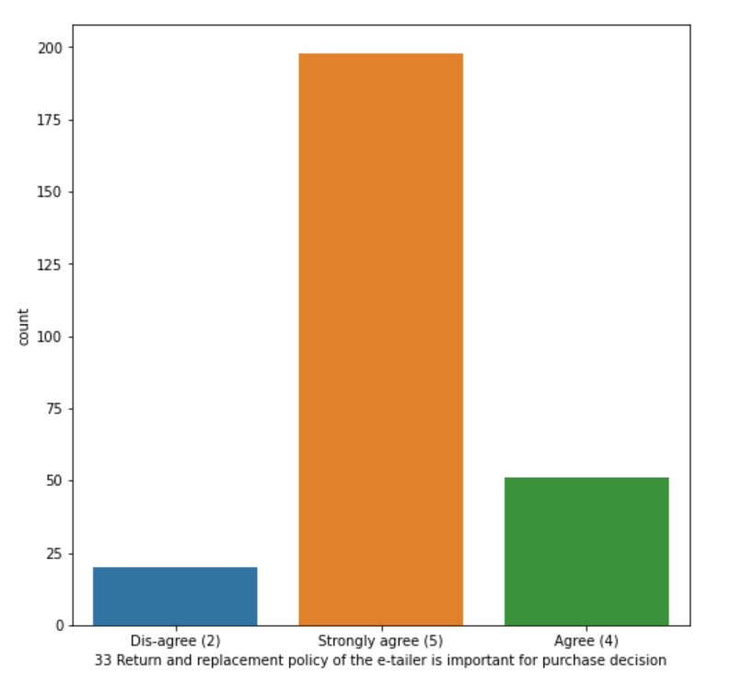
visualising how much replacement policy matters to customers

Slide 5
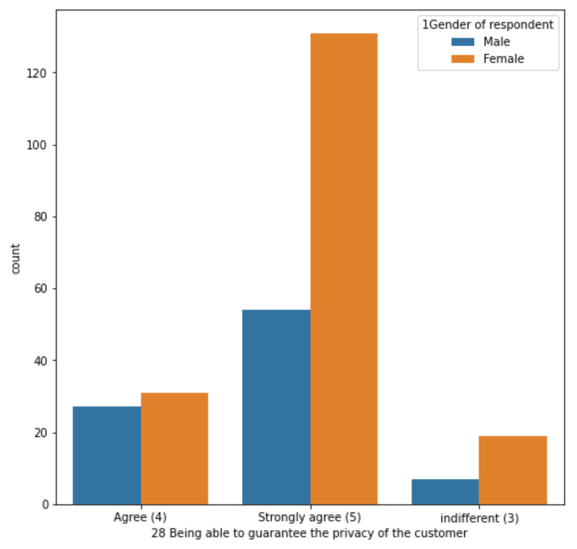
visualising which gender has privacy as their priority

Slide 6
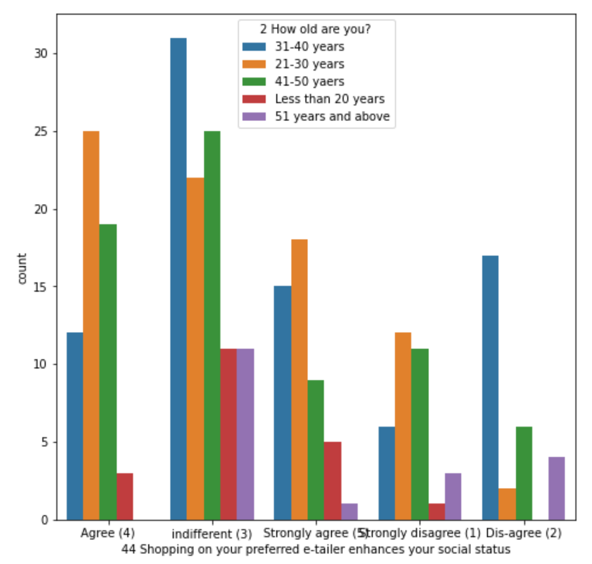
visualising does purchasing from a prefered e-tailer enhances the social status

Slide 7
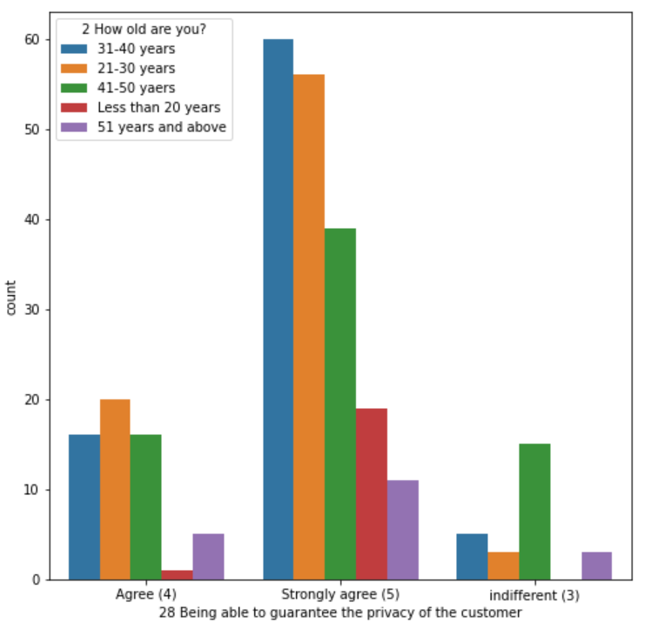
visualising which age group has privacy as one of their priority

Slide 8
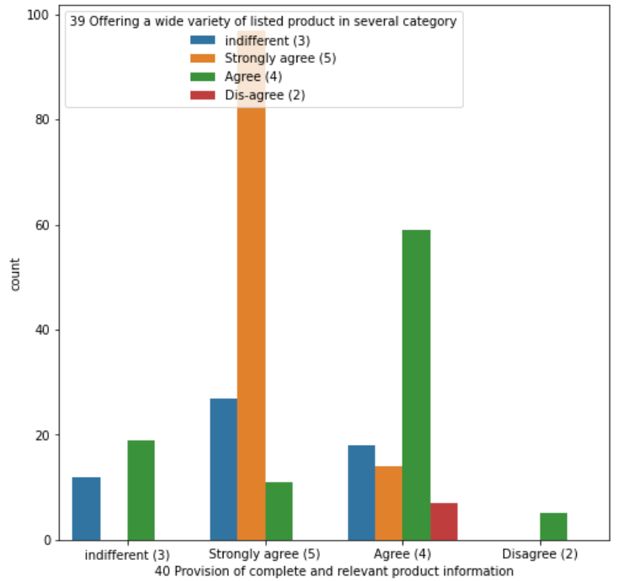
visualising how strongly people agree that having all the relevant information clear and providing wide variety of products and category is vital

